Slide 1
Online Inspection of Packed Cases
PSCS69 Capstone Project
Review-1
Batch Number: G-125
Student Name | Roll Number
B HARINATH REDDY | 20211CSE0845
D LAKSHMI NIRANJAN REDDY | 20211CSE0838
NOOKALA PAVAN KUMAR | 20211CSE0839
D SAI ESWARA REDDY | 20211CSE0516
K DINESH | 20211CSE0709
Student Name | Roll Number
Under the Supervision of,
Dr./Mr./Ms./Prof. SUKRUTH GOWDA
Professor / Associate Professor / Assistant Professor
School of Computer Science and Engineering
Presidency University
Name of the Program: B. Tech
Name of the HoD: Dr. Asif Mohammed H.B
Name of the Program Project Coordinator: Dr. Amarnath J.L & Dr. Jayanthi K
Name of the School Project Coordinators: Dr. Sampath A K / Dr. Abdul Khadar A / Mr. Md Ziaur Rahman

Slide 2
Abstract
In the agricultural sector, ensuring the quality of packed products, is crucial to maintain customer satisfaction. Current inspection processes are often carried out manually, which leads to inefficiencies and inconsistencies. This project proposes an automated solution using Artificial Intelligence (AI) and Image Processing techniques to inspect packed cases in real-time.
By automating the inspection process, the aim is to improve the accuracy, consistency, and scalability of quality assurance tasks, particularly focusing on Color, Ripeness, and Uniformity. This project proposes an advanced Artificial Intelligence (AI) and Image Processing system to automate the inspection. The goal is to implement a system that can analyze key attributes such as color, ripeness, and uniformity of the packed cases in real-time, providing immediate feedback to factory operators.

Slide 3
Literature Review
“Deep Learning. MIT Press.”
Author : Goodfellow, I., Bengio, Y., & Courville, A.
Algorithm Used:
Deep Neural Networks (DNNs): The book covers a wide range of deep learning architectures such as Convolutional Neural Networks (CNNs), Recurrent Neural Networks (RNNs), and generative models like Generative Adversarial Networks (GANs).
Drawbacks:
Computationally Expensive: Training deep networks requires a lot of computational power and memory.
Overfitting: Deep networks can easily overfit, especially when trained on small datasets.

Slide 4
Literature Review
“YOLOv3: An Incremental Improvement.”
Author : Redmon, J., & Farhadi, A.
Algorithm Used:
Darknet-53 Backbone: YOLOv3 uses Darknet-53, a 53-layer convolutional neural network, as its backbone. This network is pre-trained on ImageNet, allowing it to perform feature extraction from images efficiently.
Drawbacks:
Lower Accuracy for Small Objects: Although YOLOv3 performs better on smaller objects than its predecessors, its performance on very small objects is still not as accurate as models like Faster R-CNN or SSD. Small objects may be missed or poorly localized.

Slide 5
Literature Review
“ImageNet Classification with Deep Convolutional Neural Networks.”
Author : Krizhevsky, A., Sutskever, I., & Hinton, G. E.
Algorithm Used:
Convolutional Neural Networks (CNNs): A CNN is a type of deep neural network specifically designed for processing structured grid data like images. CNNs use convolutional layers to automatically extract features from raw image data.
Drawbacks:
Sensitivity to Hyperparameters: AlexNet is very sensitive to hyperparameters like learning rate, batch size, and weight initialization.

Slide 6
Existing method Drawback
The current inspection method relies on manual inspection by experts, which suffers from several drawbacks:
Limited Inspection Rate: Only 10% of packed cases are inspected due to space and manpower limitations.
Delayed Feedback: Inspections are carried out one day after the packing process, making real-time corrective action impossible.
Subjectivity: Human judgment introduces bias and inconsistency in the inspection process, which can vary based on personal, business, and environmental factors.

Slide 7
Proposed Method
Image Acquisition:
Images of each packed case are captured using high-resolution cameras installed at various inspection points in the factory.
Preprocessing and Data Augmentation:
The captured images undergo preprocessing, including resizing, normalization, and data augmentation, to make them compatible with the AI model and to improve model generalization.
Augmentation techniques: Rotation, flipping, and contrast adjustment are applied to simulate different inspection conditions.
AI Model - Convolutional Neural Networks (CNNs):
A pre-trained CNN model (such as ResNet or YOLO) is fine-tuned to classify the packed cases into different categories based on color, ripeness, and uniformity.
Feature Extraction:
The CNN extracts high-level features such as color distributions, ripeness status, and uniformity metrics from the images.

Slide 8
Objectives
Automate the inspection process for packed cases to increase the percentage of cases inspected from 10% to near 100%.
Enable real-time quality checks, reducing delays and providing opportunities for immediate corrective actions.
Ensure consistency and objectivity in quality assessments by eliminating subjective human judgment.
Implement a scalable solution that can adapt to different product types, particularly focusing on agricultural crops.

Slide 9
Methodology/Modules
Data Collection & Preprocessing:
Collection of images of packed cases in various conditions (good, bad, unripe, etc.).
Model Development:
A Convolutional Neural Network (CNN) will be developed and trained using TensorFlow and Keras on labeled images for packed cases.
System Integration:
The model will be integrated into a web application using Django for user-friendly image upload and real-time predictions.
Real-Time Processing:
The system will analyze uploaded images in real-time, providing instant feedback regarding the quality of the case.

Slide 10
Architecture
Frontend (HTML/CSS/JavaScript): The user interface for uploading images and viewing results.
Backend (Django): Handles image uploads, preprocessing, and communicates with the AI model.
AI Model (TensorFlow/Keras): A trained CNN model loaded into the backend for image classification.
Database (optional): Stores historical records of inspected cases and user feedback.

Slide 11
Hardware/software components
Hardware:
GPU (optional) for fast training of the CNN model.
Standard CPU for running the Django application.
Software:
Python 3.7+
Django Web Framework
TensorFlow/Keras for deep learning model development.
OpenCV for image preprocessing.
HTML, CSS, JavaScript for the frontend design.
Database (SQLite/MySQL) (optional for storing records).

Slide 12
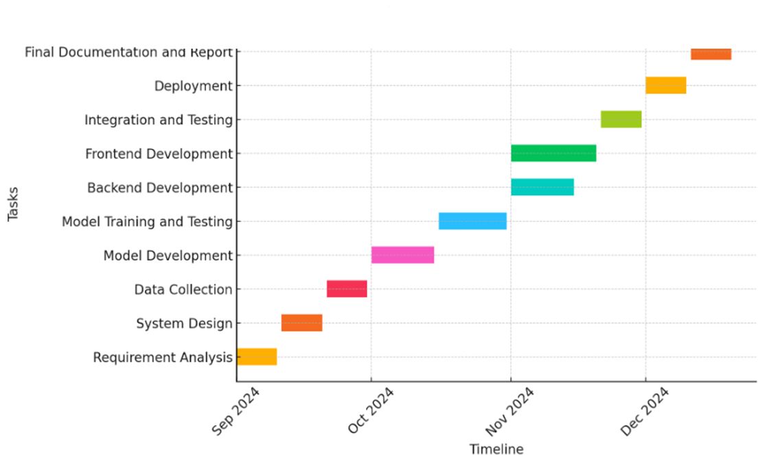
Timeline of Project

Slide 13
Expected Outcomes
Automated Real-Time Inspection: The system will enable automated and real-time inspection of packed cases.
Improved Efficiency: Inspection coverage will be increased from the current 10% to near 100%.
Objectivity in Inspection: The removal of subjective human judgment will lead to consistent and reliable inspection results.
Increased Customer Satisfaction: By ensuring only quality products are dispatched, the system will help maintain high customer satisfaction.

Slide 14
Conclusion
The proposed AI-driven system will automate the inspection process of packed cases, overcoming the current limitations of manual inspections. By integrating AI and Image Processing, the system can provide real-time quality assessments based on predefined standards such as color, ripeness, and uniformity.
The result is a more efficient, scalable, and consistent inspection process that can significantly enhance operational efficiency and customer satisfaction.

Slide 15
Github Link
The Github link provided should have public access permission.
Github Link
https://github.com/harinath206/online-inspectiojn-of-packed-cases

Slide 16
References
Goodfellow, I., Bengio, Y., & Courville, A. (2016). Deep Learning. MIT Press.
Redmon, J., & Farhadi, A. (2018). YOLOv3: An Incremental Improvement. arXiv preprint arXiv:1804.02767.
Krizhevsky, A., Sutskever, I., & Hinton, G. E. (2012). ImageNet Classification with Deep Convolutional Neural Networks. Advances in Neural Information Processing Systems, 1097–1105.
Zhao, Z., Zheng, P., Xu, S., & Wu, X. (2019). Object Detection with Deep Learning: A Review. IEEE Transactions on Neural Networks and Learning Systems, 30(11), 3212-3232
Rajpurkar, P., Jia, R., Liang, P. (2018). Know What You Don't Know: Unanswerable Questions for SQuAD.

Slide 17
Thank You

